Slide 1
Array and List

Slide 2
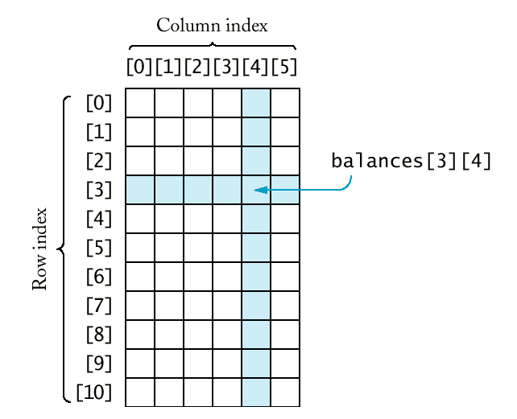
Array
Indexed collection of data
C# Arrays are zero indexed i.e. starting index from zero
stored in continuous form in memory

Slide 3
Declaring an array:
type[] name;
e.g.
int[] studentList;
names = new string[10];
Or
string[] names = new string[10];
Or
int[] numbers = new int[] {1,2,3,4,5};

Slide 4
Setting elements
Elements are stored in an array either by direct access
Names[2] = "Raymond";
Sales[19] = 23123;
or by calling the Array class method SetValue
names.SetValue[2, "Raymond"];
sales.SetValue[19, 23123];

Slide 5
Accessing elements
Array elements are accessed either by direct access or by calling the GetValue method.
myName = names[2];
monthSales = sales.GetValue[19];

Slide 6
Iterating array elements
It is common to loop through an array in order to access every array element using a For loop
for (int i = 0; i <= sales.Length; i++)
totalSales = totalSales + sales[i];
Or using Foreach loop
foreach(int x in sales)
Console.WriteLine(x)

Slide 7
Multi-dimension
In real world, we have lot of data which can’t represent by a single value
A position on earth – latitude and longitude
A student’s result – Name, Marks1, Marks2, …
if data can be represent in a table format then it can store in a 2 dimension arrays! – most commonly used multi-dimension array.
Array can be 3-dimension or n-dimension as well

Slide 8
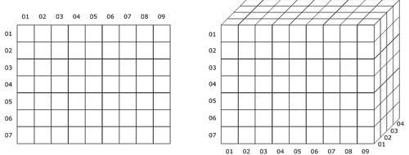
2 – Dimension
3 – Dimension

Slide 9
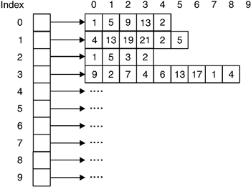
Jagged Array
Array whose elements are array
In two dimension, all dimension must be of same size
In Jagged array, elements can be of different dimension and sizes
int[][] jaggedArray = new int[9][];
jaggedArray[0] = new int[5];
jaggedArray[1] = new int[6];
jaggedArray[2] = new int[4]; .
.

Slide 10
Parameter Array
Usually we write methods require a set of parameters to be provided, like method for addition of two numbers.
A method for addition of ‘n’ numbers?
Optional number of parameters
A parameter array is specified in the parameter list of a method definition by using the keyword ParamArray.
static int sumNums(params int[] nums) {
int sum = 0;
for(int i = 0; i <= nums.GetUpperBound(0); i++)
sum += nums[i];
return sum;
}
How it is different than passing an array as parameter?

Slide 11
Finding an Element in an Array
We need to iterate each elements of array and check whether current element is required element or not
If required element found then return current index – position of found element
int Find(int[] data, int e)
Otherwise, must return something to identify required elements not found -? What should we return?
Simple for – count
Foreach loop

Slide 12
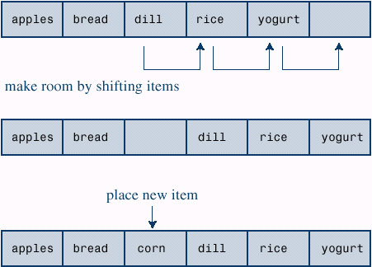
Inserting an element into Array
Find location - O(n)
Make room by shifting - O(n)
Place new element- O(1)
What about deletion?
Assignment:
Write code for insertion and deletion an element in array

Slide 13
Retrieving Array’s Metadata in C#
Length: Returns the total number of elements in all dimensions of an array.
GetLength: Returns the number of elements in specified dimension of an array.
Rank: Returns the number of dimensions of an array.
GetType: Returns the Type of the current array instance.

Slide 14
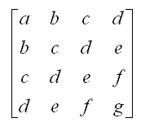
Matrixes and Arrays
It is an array of numbers (or variables, or expressions), arranged in rows and columns
How to represent a matrix in program?
Hint: Tabular data?
Two Dimension Array!!!
Operations on Matrix
Addition
Subtraction
Multiplication
….

Slide 15
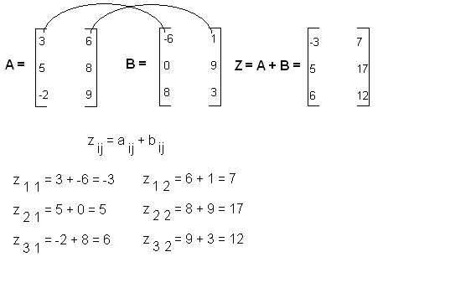
Addition / Subtraction of Matrixes

Slide 16
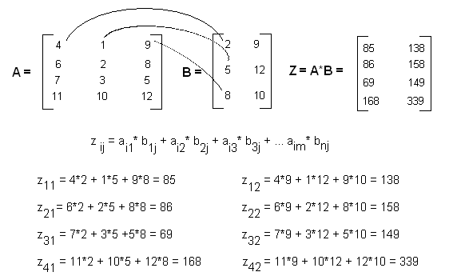
Multiplication of Matrixes

Slide 17
ADT for Matrix
Matrix ADT must allow to add elements in matrix
Allow different operations like addition , subtraction, multiplication etc
class Matrix
{
int[] matrix;
public Matrix(int row, int col)
{
matrix = new int[row,col];
}
public void Add(int r, int c, int e) { … }
……
}

Slide 18
Polynomial ADT
Polynomials: defined by a list of coefficients and exponents where each coefficient is unique
degree of polynomial = the largest exponent in a polynomial
A set of ordered pairs <e_{i}, a_{i}> where a_{i} is the coefficient and e_{i} is the Exponent
Polynomials A(X)=3X²⁰+2X⁵+4, B(X)=X⁴+10X³+3X²+1

